Slide 1

Optimized Location for Job Opportunity
David Tan
Chenghan Wen
Moxuan Li

Slide 2
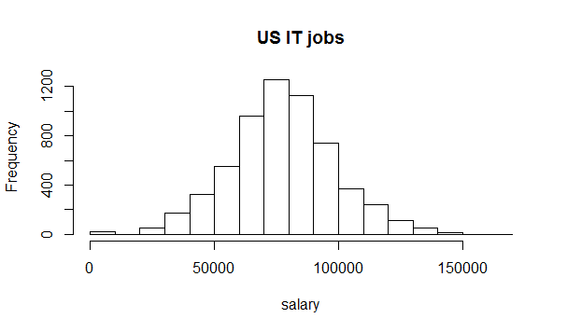
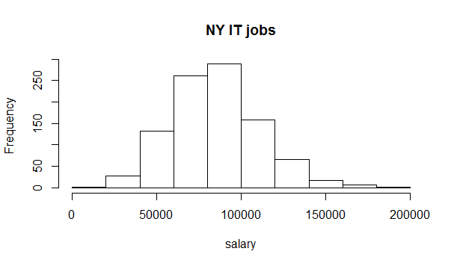
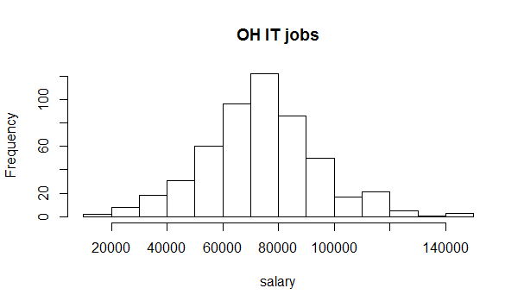
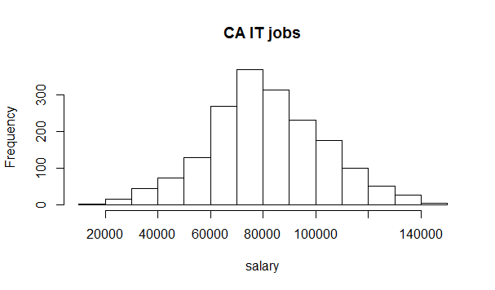
Mean: 78k
SD:21k
Mean: 85k
SD:26k
Mean: 74k
SD:20k
Mean: 81k
SD:22k

Slide 3
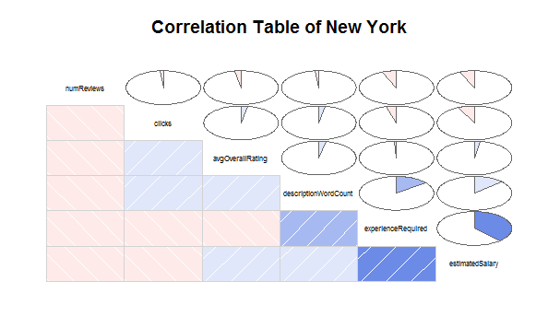
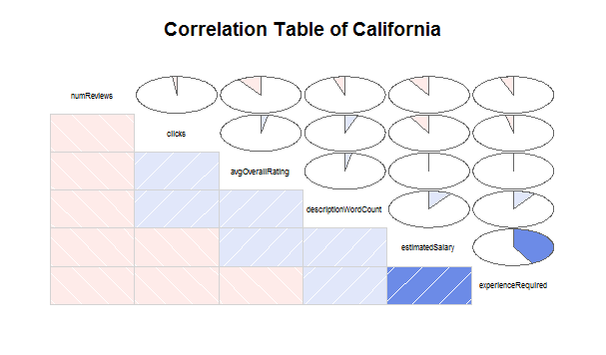
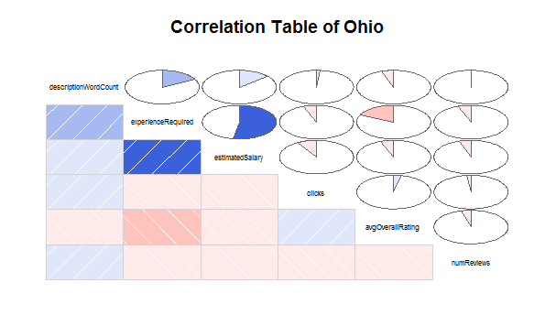
Correlation Between Variables

Slide 4
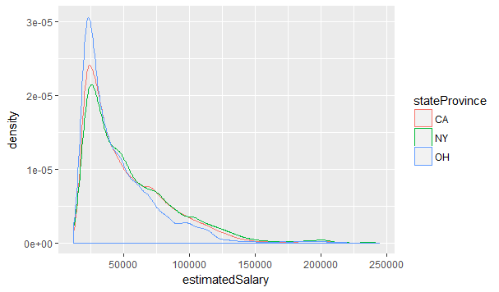
Conclusion

